Slide 1
Projectile Motion
Leszek Nowak
Faculty of Physics, Astronomy and Applied Computer Science
Jagiellonian University

Slide 2
Finding ballistic solution and target leading

Slide 3

Finding ballistic solution and target leading
Równanie kwadratowe:
$$ay^{2}+by+c=0, y=\frac{−b ±\sqrt{b^{2}−4ac}}{2a}, ∆=b^{2}−4ac$$
Równanie ruchu:
$$S=\frac{1}{2}at^{2}+V_{0}t+S_{0}, V=V_{0}+at$$

Slide 4
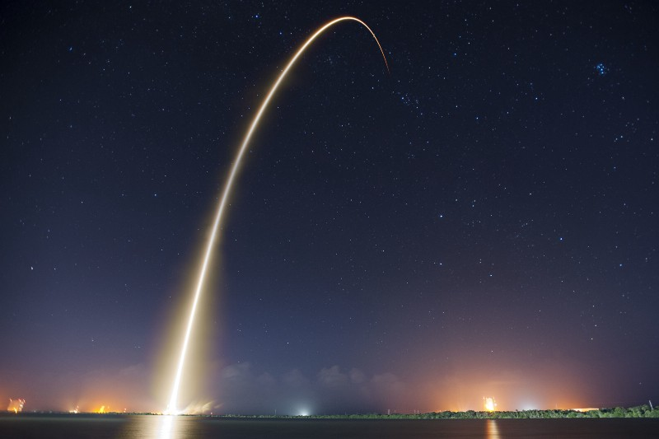
Read those:
www.forrestthewoods.com/blog/solving_ballistic_trajectories
http://www.gamasutra.com/blogs/KainShin/20090515/83954/Predictive_Aim_Mathematics_for_AI_Targeting.php

Slide 5

//
johnmeadow.itch.io
github.com/JohnMeadow1
www.reddit.com/user/JohnMeadow2
twitter.com/JohnMeadow3
www.doit.fais.uj.edu.pl/leszek-nowak

